Slide 1

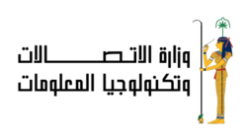


Slide 2

End-to-End
Fraud Detection System
Instructor: Eng. Abdullah Mahmoud

Slide 3






Our Team
Abdalrahman
Amr
Rawda
Hager
Salma
Somaia

Slide 4

Overview
This project implements a complete end-to-end fraud detection system for banking transactions, combining:
Database design
ETL pipelines
Data warehousing
Cloud data engineering
Machine learning
Web application for visualization and fraud prediction
The system is designed to:
Detect fraudulent transactions
Provide insights into customer and merchant risk
Automate data processing pipelines using cloud technologies

Slide 5
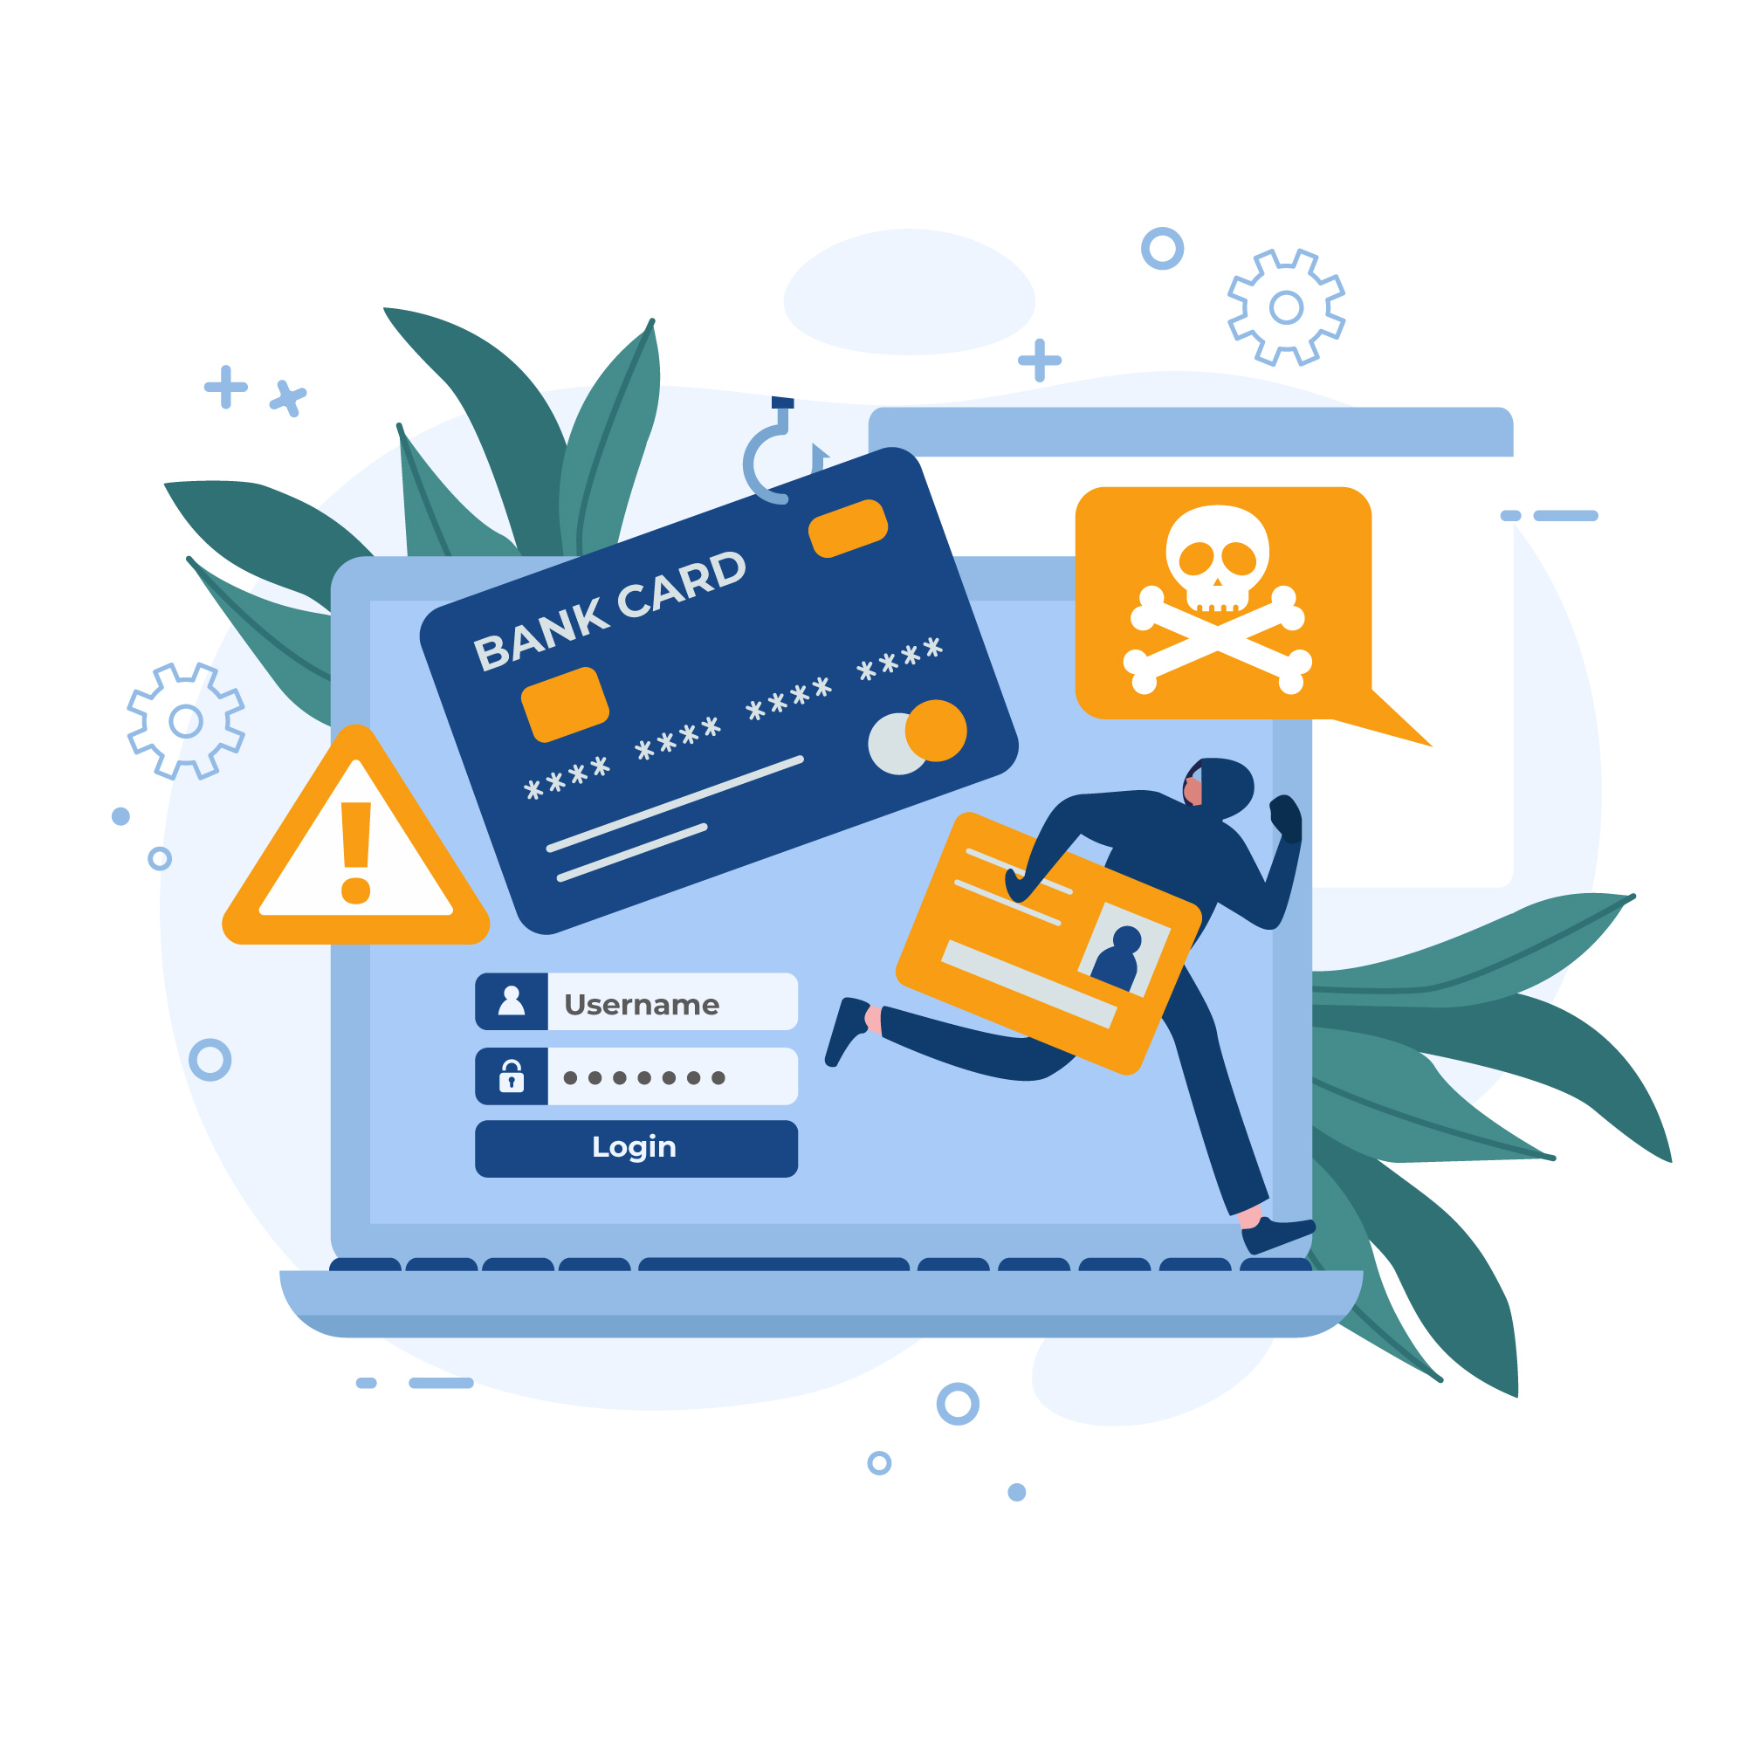
Problem statement
Digital banking transactions are increasing rapidly, and so are fraudulent activities.
There is a need for an automated, accurate, and end-to-end system that can detect fraud, support decision-making, and help admins take action quickly.
Problem 01
Problem 02
High transaction
volume makes manual fraud detection slow and unreliable.
Problem 03
Poor data quality, where raw data is messy or incomplete, reducing reliability.
No real-time detection, causing delays in catching fraud.

Slide 6



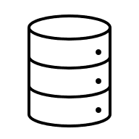
Project Objectives
Automate data processing and integration using SSIS and Airflow.
Provide dashboards and an admin web interface for real-time fraud monitoring and prediction.
Build a reliable data pipeline and warehouse to ensure clean, consistent fraud-related data.
Train and deploy an accurate machine-learning model to detect fraudulent transactions.

Slide 7
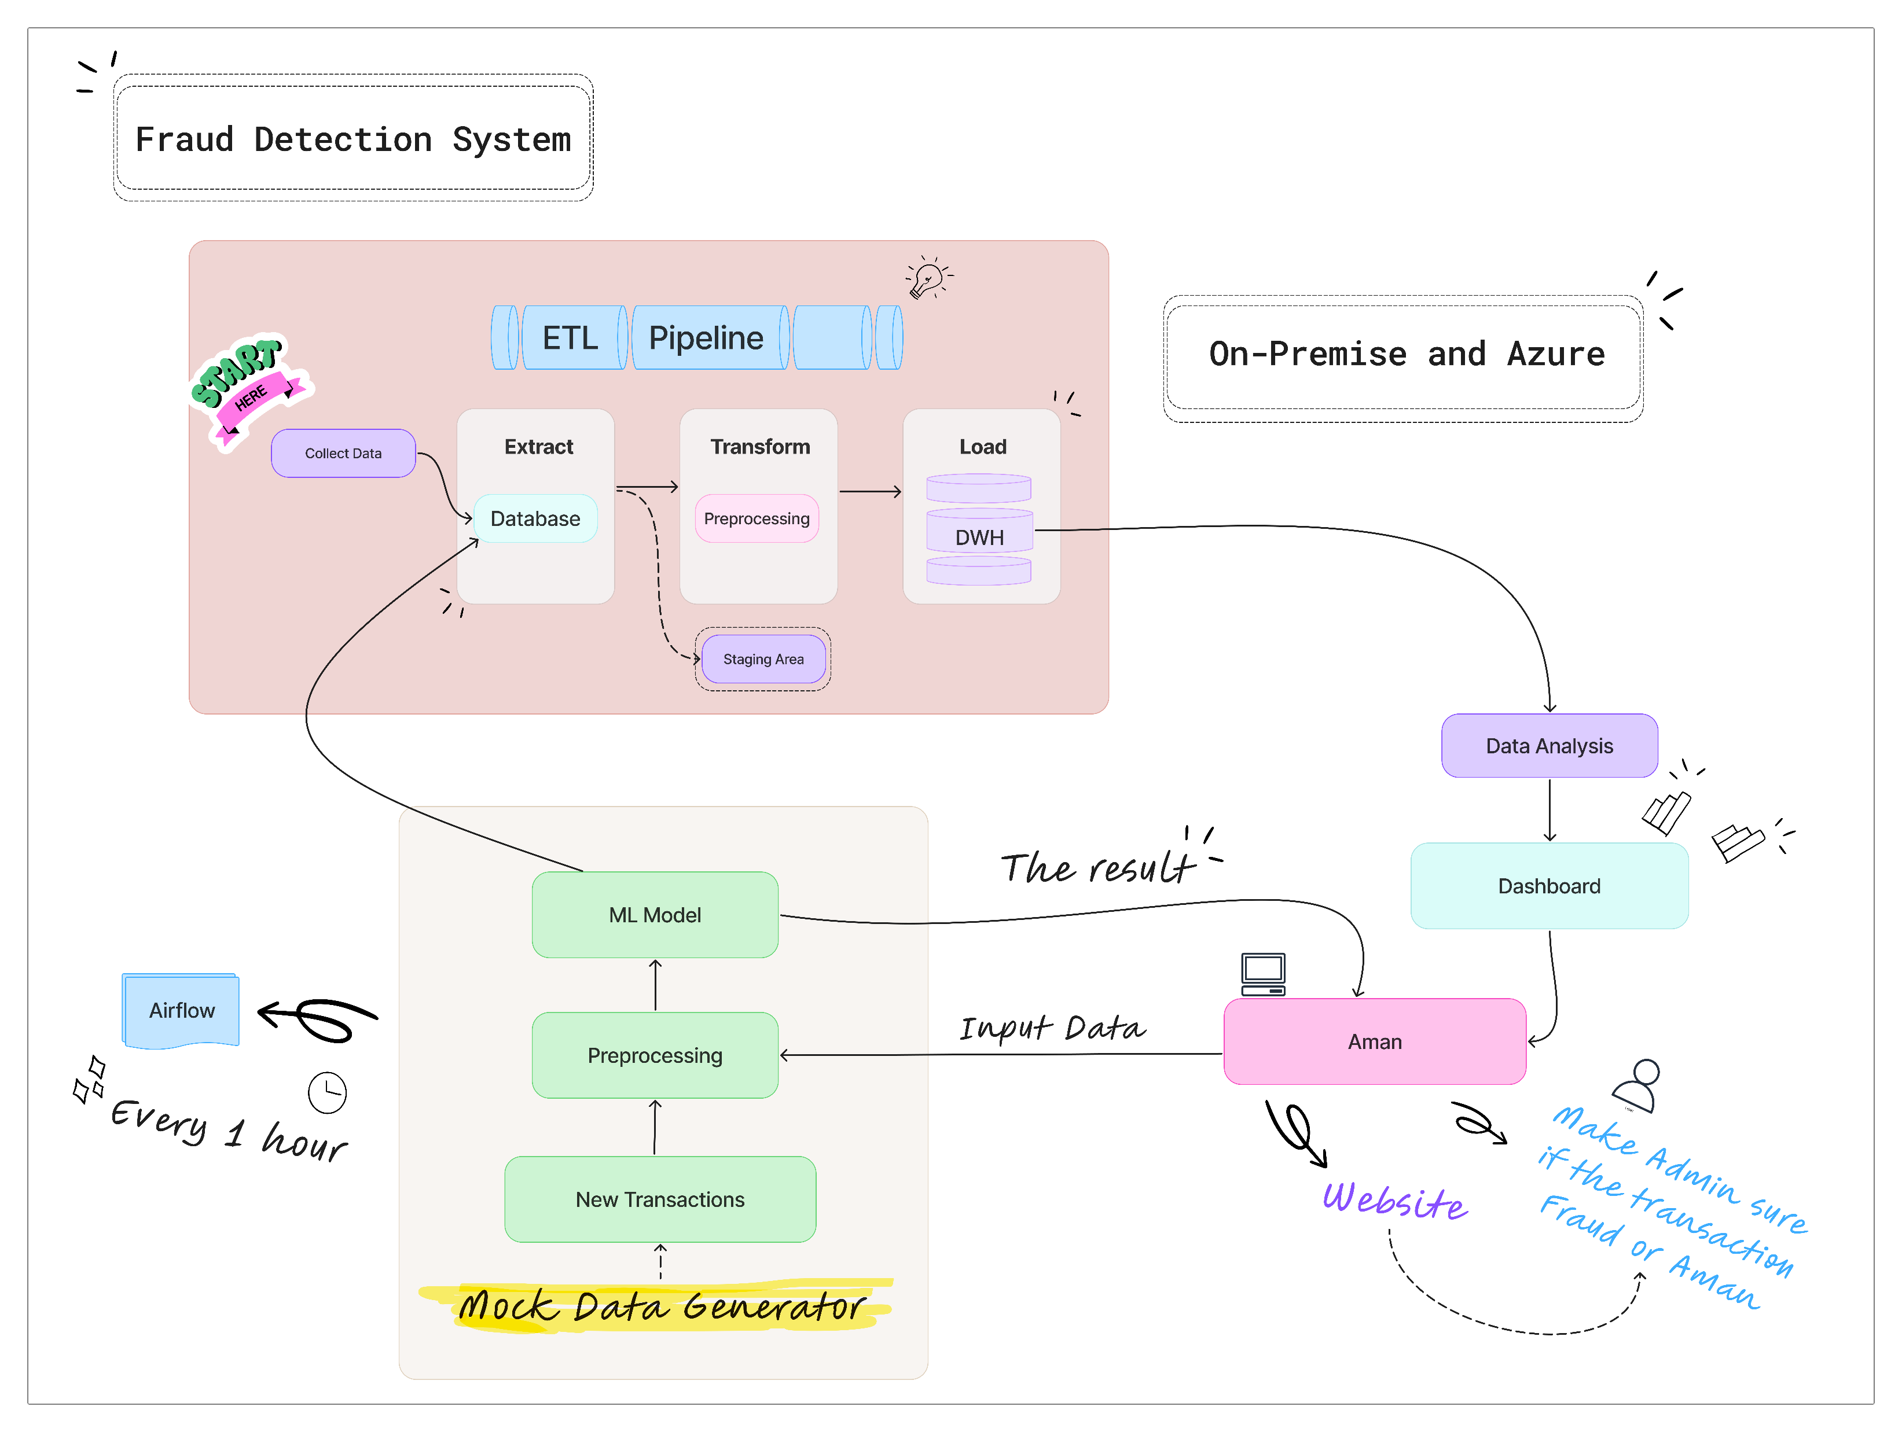
System Architecture (End-to-End Workflow)

Slide 8

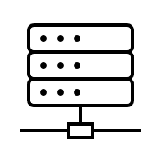


Project Milestones
Data Collection
Data Warehouse
Machine Learning
Cloud Integration
01
Collected data from multiple sources and performed initial cleaning and preprocessing.
03
05
07
Integrated data from different sources and organized it for efficient analytics.
Applied ML models to predict fraud and improve detection accuracy.
Deployed components on Azure to facilitate cloud storage and access.
Designed structured tables to store data relationally with key relationships.
Used Airflow to automate and schedule data pipelines consistently.
Created an interactive dashboard to visualize data and model results clearly.
Built a user-friendly web interface to allow users to check for fraud directly.
02
04
06
08
Database
Data Orchestration
Data Analysis
Aman

Slide 9
Project tools & technologies
Python Pandas NumPy
Data Warehouse
Machine Learning
Cloud Integration
Data Collection
SSMS SSIS Star Schema Design
01
03
05
Python
NumPy
Pandas
Seaborn
TensorFlow
Scikit-learn
XGBoost
JobLib
07
Microsoft Azure
Azure Storage
Azure SQL
Azure Data Factory
Azure Databricks
CSS
HTML
Jave Scripte
Streamlit-Option-Menu
Streamlit-Lottie
Node.js
Docker
SSMS
DML
DDL
Apache Airflow
Power BI
02
04
06
08
Database
Data Orchestration
Data Analysis
Aman

Slide 10
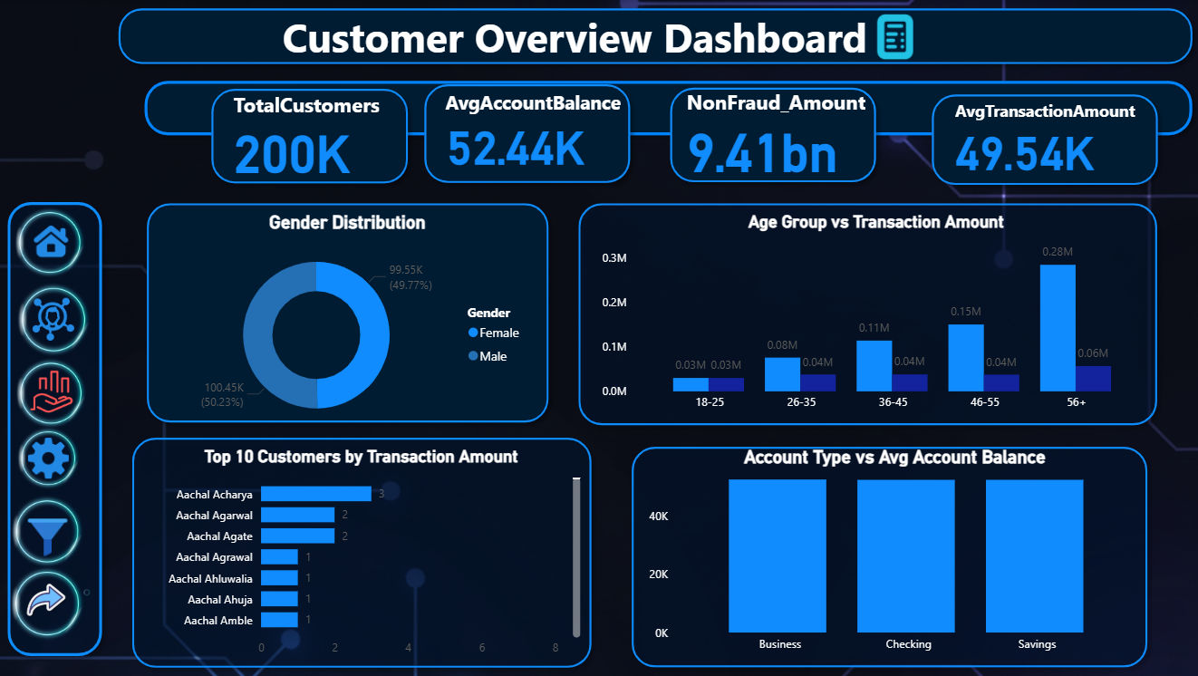
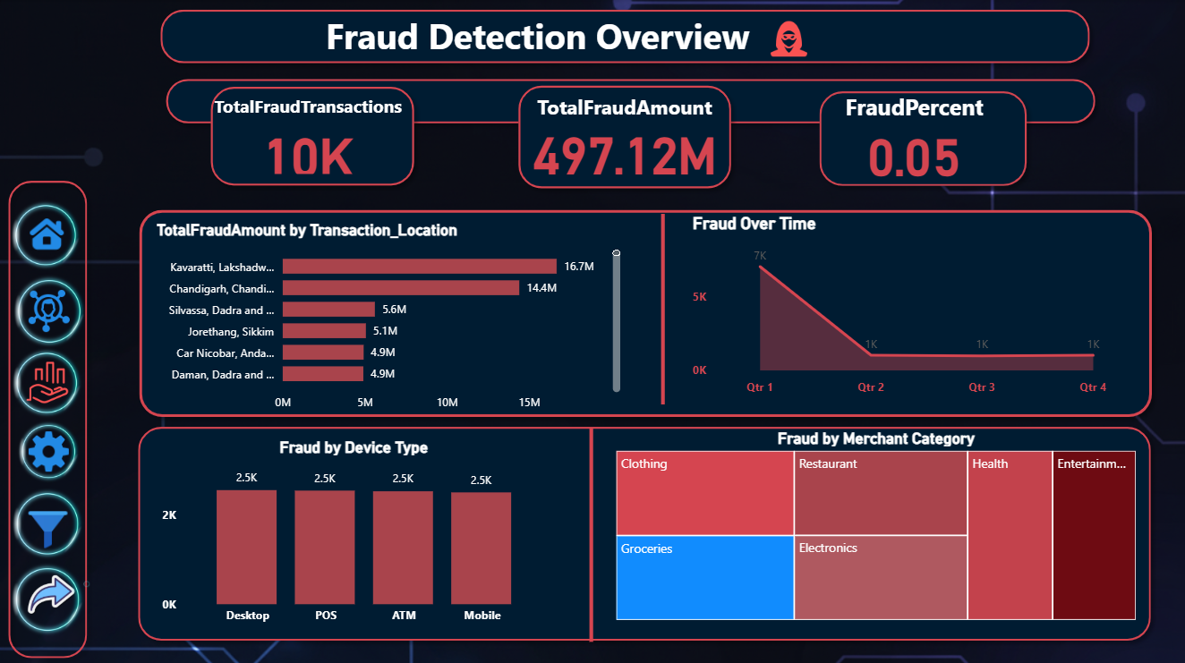
Data Analysis & Dashboard
Interactive dashboards providing insights into customers and real-time fraud detection for effective monitoring and decision-making.
This dashboard shows key customer metrics such as total customers, average balances, and transaction amounts, while visualizing demographics and behavior for quick insights into trends, risks, and top-performing customers.
This dashboard provides a clear view of fraudulent activity, showing total fraud transactions, total fraud amount, and fraud percentage. It also visualizes fraud patterns across transaction locations, time, device types, and merchant categories, helping to identify trends and high-risk areas.

Slide 11
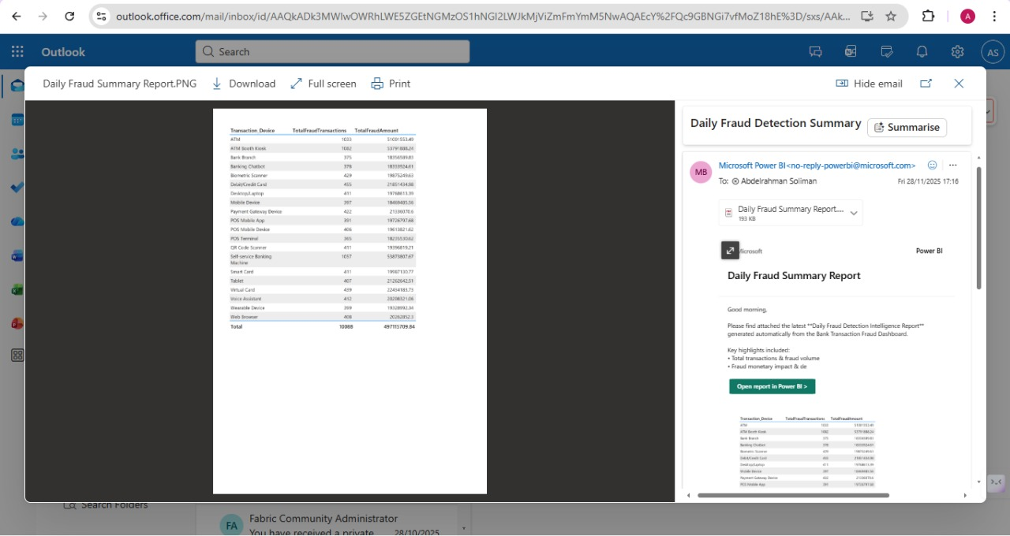
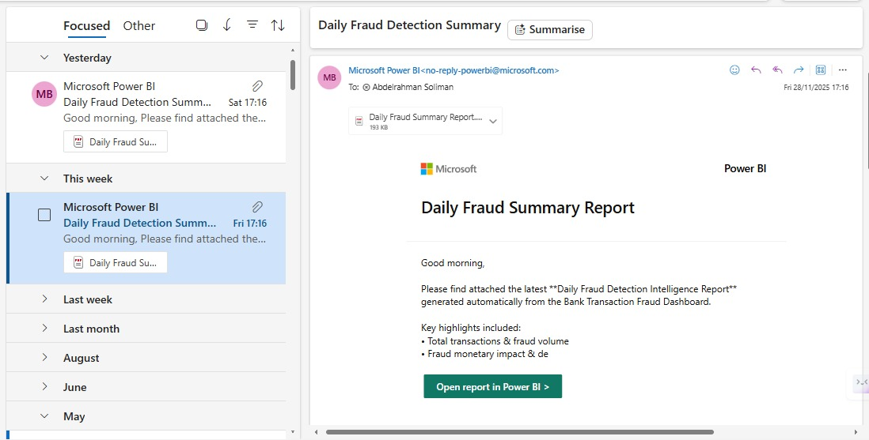
Automation & Notifications
Automatically sends
daily
fraud
report
to
owner
The email report provides a clear summary of
fraudulent activity, including total fraud
transactions, total fraud amounts, and the
devices used in those transactions.

Slide 12
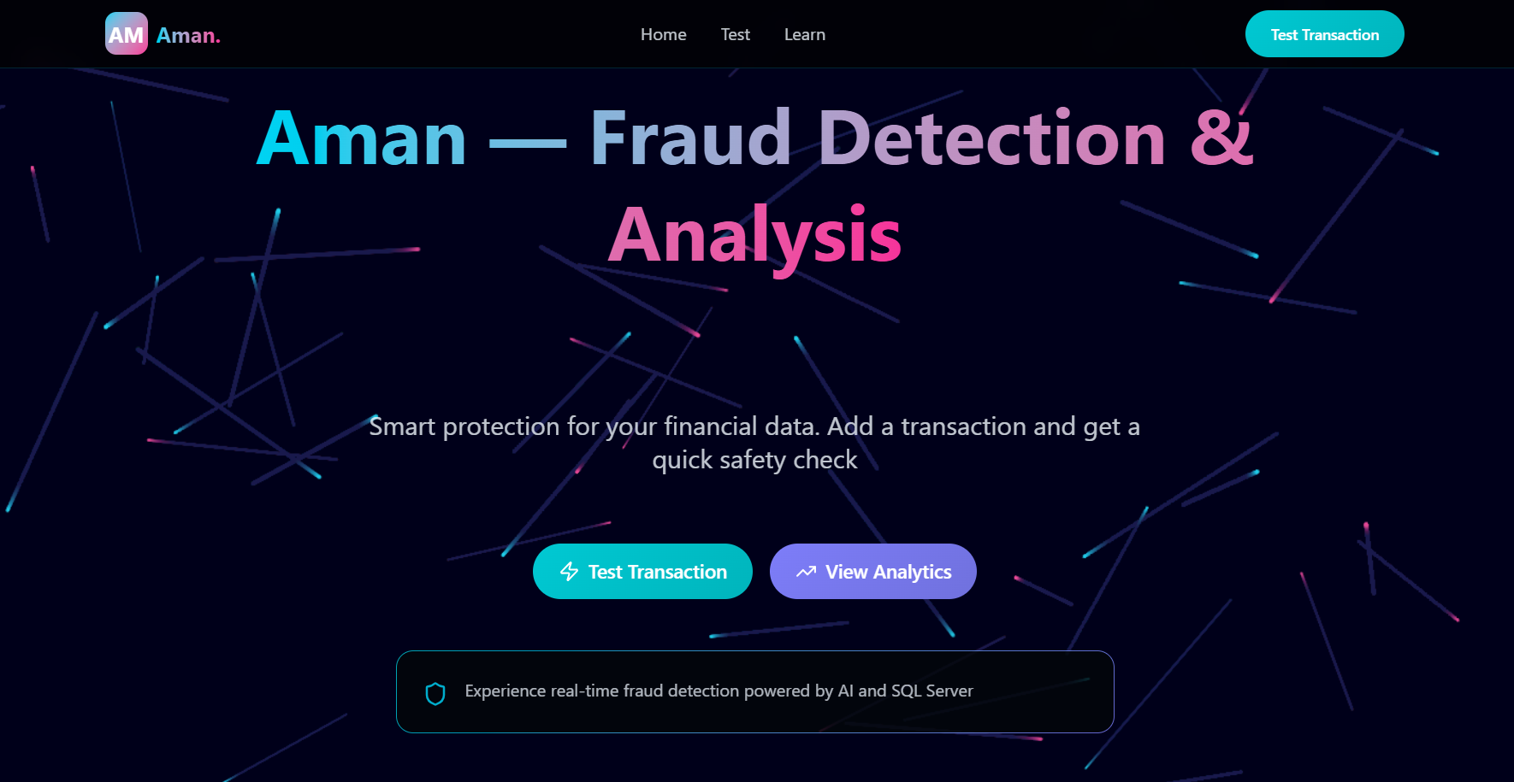
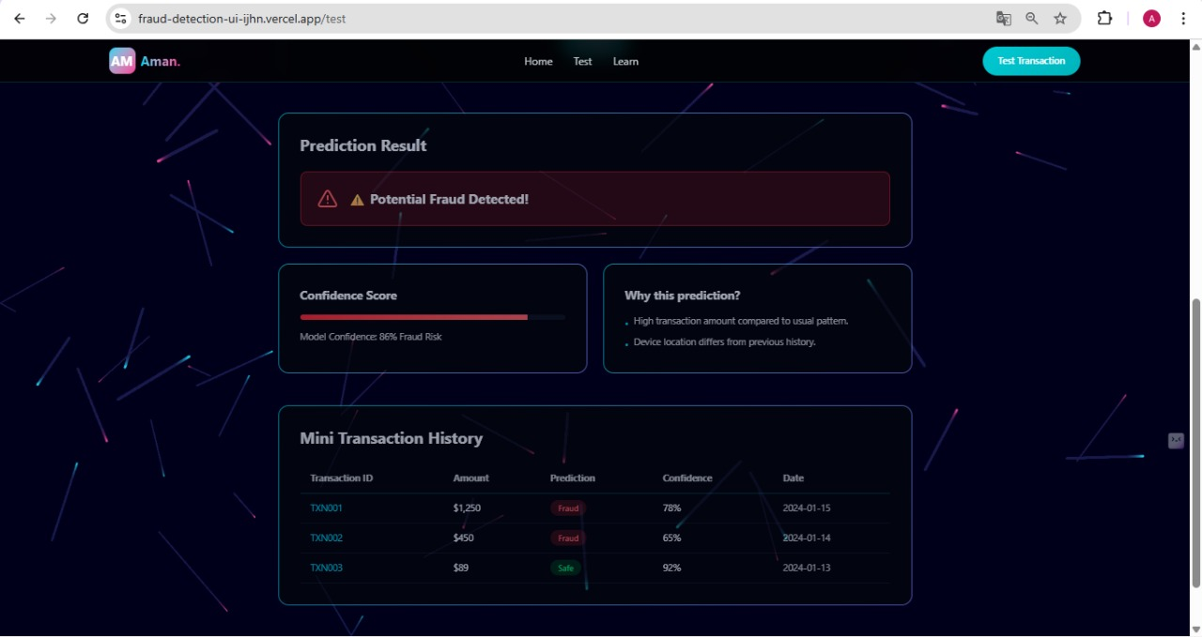
Aman – Fraud Detection Web Application
Transaction Detected as Fraud
A secure and intelligent web platform that assists admins in monitoring financial transactions and identifying potential fraud using automated detection mechanisms.
Click here

Slide 13
Thank you for your attention
This is just the beginning, not the end

